Slide 1
Getting Off to a Good Start: The Importance of Early Childhood to Lifelong Health Amy D. Herschell, Ph.D. June 30, 2022 2:30pm – 4:00pm

Slide 2
WELCOME
What to Expect
Interactive
Relevant
What I Request
Participation (Chat)
Attention

Slide 3
Overview
How early childhood affects lifelong health and learning
The impact of COVID on children
nationally and in Pennsylvania
Mental health treatment for young (preschool) children

Slide 4
How early childhood affects lifelong health and learning
What do we know about early childhood?
Social/Emotional Development
Language and Communication
Cognition
Movement/Physical Development
What is the impact of toxic stress on children?
Important Milestones: Your Baby By Three Years | CDC

Slide 5
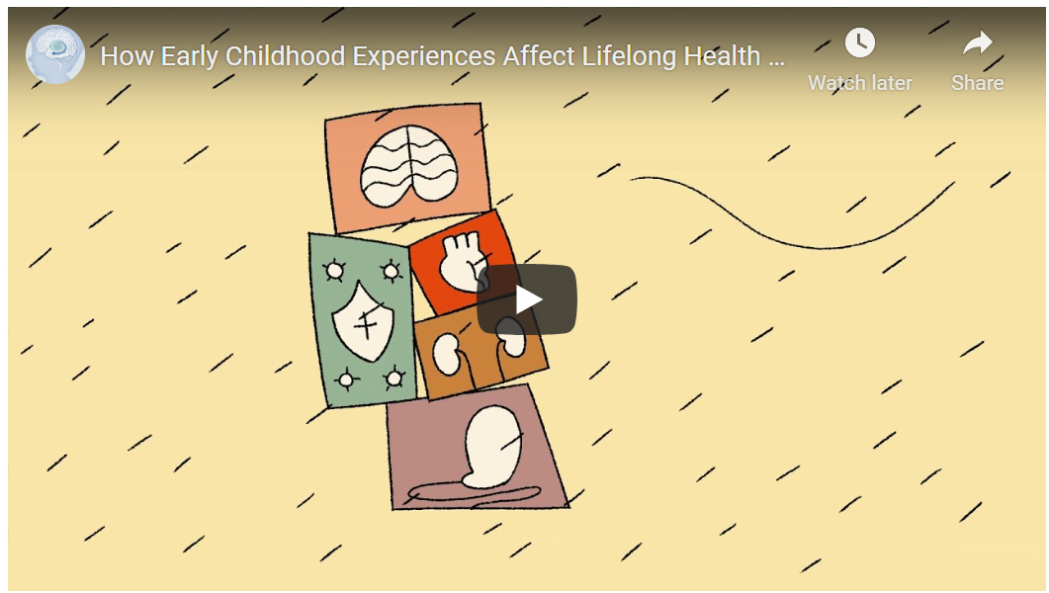
VIDEO
How Early Childhood Experiences Affect Lifelong Health and Learning - Center on the Developing Child at Harvard University

Slide 6
How Early Childhood Experiences Affect Lifelong Health and Learning - Center on the Developing Child at Harvard University
VIDEO

Slide 7
This is MORE IMPORTANT than ever now!
The Impact of COVID on Children
27% of parents reported worsening mental health for themselves, 14% reported worsening mental health for their children (Patrick et al., June 2020).
Mental health-related emergency department visits increased 24% among children and 31% among adolescents in 2020. (CDC)
Patrick, S.W., Henkhaus, L. E., Zickafoose, J. S., et al. (2020). Well-being of Parents and Children During the COVID-19 Pandemic: A National Survey. Pediatrics, 146(4), DOI: https://doi.org/10.1542/peds.2020-016824

Slide 8
The Impact of COVID on Children (continued)
Increased
Social Isolation
Health and Safety Concern
Caregiver Stress (e.g., work, financial)
Family Conflict (parent–child conflict, and/or child abuse, intimate partner)
Screen Time
Sedentary Behaviors
Decreased
Prosocial activities (school, sports, social activities, hobbies)
Access to medical and mental health care
Adjustment and Re-adjustment to online schooling processes and demands
Meade (2021)
Mental Health Effects of the COVID-19 Pandemic on Children and Adolescents - PMC (nih.gov)

Slide 9
PAYS: Pennsylvania students in 6, 8, 10 and 12th grade
Protective factors decreased
Increases in the following mental health concerns
Self-harm (17.6%)
Felt depressed or sad MOST days (40.1%)
Sometimes I think that life is not worth it (27.9%)
At times I think I am no good at all (38.6%)
I am inclined to think that I am a failure (26.2%)
Increases in the following suicide risk behaviors
So sad stopped doing usual activities (31%)
Seriously considered suicide (18.6%)
Planned suicide (14.7%)
Attempted suicide (10.9%)
Needed medical treatment for suicide attempt (2.2%)
State Reports_State of Pennsylvania Profile Report.pdf (pa.gov)

Slide 10
What matters most?
“The single most common factor for children who develop resilience is at least one stable and committed relationship with a supportive parent, caregiver, or other adult.”
Center on the Developing Child
at Harvard University

Slide 11
Parent-Child Interaction Therapy (PCIT)

Slide 12
Parent-Child Interaction Therapy (PCIT)
An evidence-based intervention for young children (ages 2.5 to 7 years) with disruptive behaviors and their families
Work with the caregiver (birth, kin, foster, adoptive) and child together
Use of coaching with a ‘bug-in-the-ear’ from a one-way mirror

Slide 13
VIDEO: Parent Child Interaction Therapy Overview
https://www.youtube.com/watch?v=zLvUuRYc2eg&app=desktop

Slide 14
Parent-Child Interaction Therapy
Consists of two phases of treatment:
Child Directed Interactions (CDI) or relationship enhancement
Parent Directed Interactions (PDI) or child behavior management
Goals of treatment include:
Promote a warm, nurturing caregiver-child relationship
Increase child’s prosocial behaviors while decreasing challenging behaviors
Create an enduring change in both caregiver and child behavior

Slide 15
Who is PCIT Appropriate For?
Young Children (Age 2.5 up to 7)
Children showing disruptive behaviors, such as:
Verbal or physical aggression
Defiance
Noncompliance
Temper Tantrums
Hyperactivity
Parents with harsh or overly punitive parenting
Parents who could benefit from enhanced relationship and/or behavior management skills with young children

Slide 16
What are important components of PCIT?
Parent and child together
Focus on interaction patterns
Active skills training (coaching)
Performance based (not time-limited)
Empirically supported
Assessment driven

Slide 17
Coaching is Key
We all learn by doing
Real time coaching gives parents immediate praise for what they are doing well.
Provides parents support with skills they may have more difficulty mastering
Helps parents stay calm and use selective ignoring when the child is exhibiting negative behaviors

Slide 18
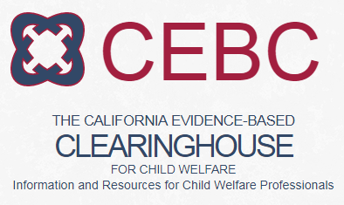
Parent Child Interaction Therapy’s Recognition as an Evidence-based Treatment
360+ publications on PCIT
50 years of research!

Slide 19
Parent Outcomes
Strong skill acquisition
More positive attitudes towards child
High parent satisfaction
Improvements in self-reports of maternal depression and parental stress

Slide 20
Child Outcomes
Observation
Decrease in disruptive behaviors
Increase in compliance
Parent Report
Child behavior improves from clinical range to within normal limits
Moderate to large effect sizes

Slide 21
Enduring Change
Treatment gains have been maintained for one to six years
Treatment gains generalize to:
Untreated siblings
Child behavior in preschool

Slide 22
What treatments are similar to PCIT?
Family Interaction Training
The Incredible Years
Triple P
The Defiant Child
Helping the Noncompliant Child
Parent Management Training

Slide 23
What should the Primary Caregiver expect from treatment?
To be actively included
To have questions answered about treatment
Length
Effectiveness
And anything else

Slide 24
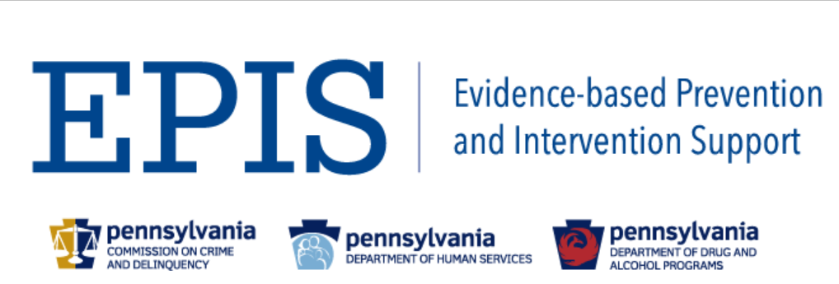
Trusted Sources of Information to Learn More
Home (pcit.org)
Welcome to EPIS... | EPIS (psu.edu)
Effective Child Therapy - By the Society of Clinical Child & Adolescent Psychology
Results First Clearinghouse Database | The Pew Charitable Trusts (pewtrusts.org)

Slide 25
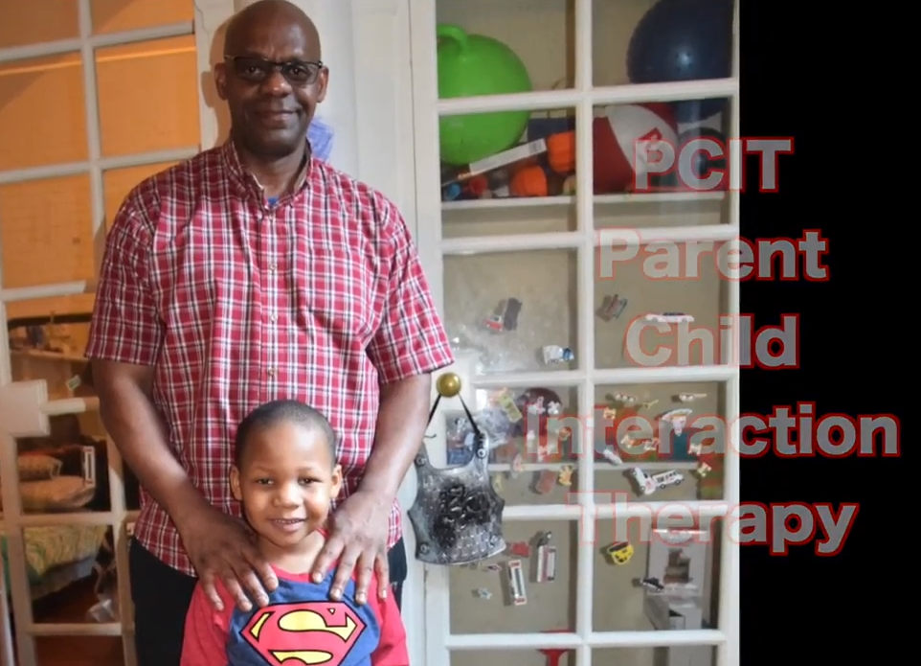
Saul and Saul Jr, A Pennsylvania Family
(1) PCIT with Saul and Saul Jr - YouTube

Slide 26
Questions, Comments & Feedback

