Slide 1


Family Member Roadmap

Slide 2
Introducing Family Member Roadmap
Model developed by families
For the purpose of supporting families
And, to illuminate the importance of engaged families
And, to ensure highest quality family support
And, to promote family driven services

Slide 3

Who are the Family Member Roadmaps For ???
Family Members: Anyone raising children and youth with mental health issues and other system involvement (like child welfare, juvenile justice, education, mental health and drug & alcohol).

Slide 4
Why are the Family Member Roadmaps Important for Families-What Will They Learn
  WHY---Research findings support that family members involved in their youth’s treatment, services, etc. produce better outcomes for the youth.
  They are NOT ALONE!!
The modules/lessons are easy to use in language families will understand.
The goal is to help families navigate the systems and give them the tools necessary to feel empowered to help their family member.
The modules/lessons can be taken alone or with a support person.
The family member can complete all at one time or skip around.
Once they are registered they can access the site as many times as they would like.

Slide 5

Key Concepts
Finding Your New Reality
Keeping Good Records
Sharing Your Child’s Story
Asking Questions to Produce Useful Answers
Making the Most of Appointment Time
Resolving Mistakes and Misunderstandings
Bringing it All Together

Slide 6

Module One Finding Your New Reality
1. Identify with other family members.
2. Recognize that though their child, family and situation are unique,there are actions they can take to help their child and themselves reach their goals.
3. Communicate the importance of the Big Picture for their child or youth.
4. Identify the importance of creating a team for their child or youth.
5. Recognize their role on the team.
6. Begin to recognize their new reality.
7. Become more familiar with basics of the ROAD MAP tips.

Slide 7
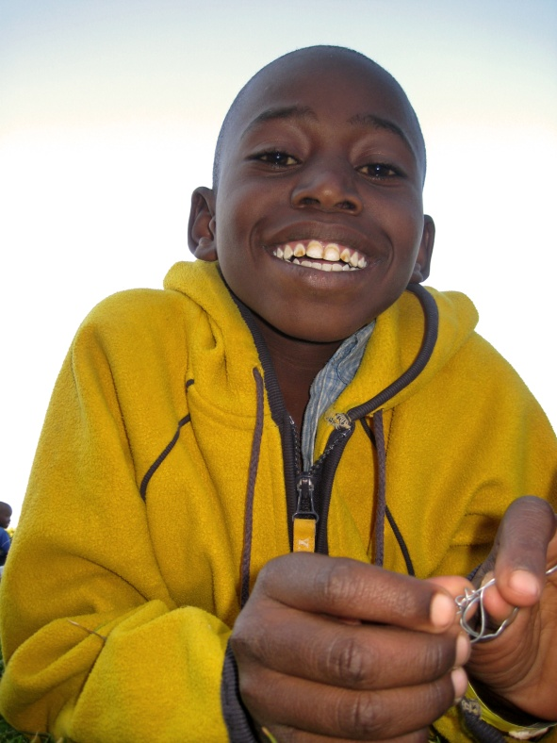
Module Two Keeping Good Records
Learning Objectives: After viewing this module the family member/learner will...
1. Identify how keeping good records can positively affect the family member, child or youth and team.
2. Recognize different ways to keep records that might work best for the individual family.
3. Describe why keeping good records is important to the family member, child or youth and team.
4. Identify the types of information that could be helpful for their child or youth.
5. Describe the importance of taking good notes.
6. List some note taking practices that can be helpful

Slide 8

Module Three Sharing Your Child’s History
Learning Objectives: After viewing this module the family member/learner will...
1. Identify the importance of communicating your child’s strengths, needs
and history with service providers and system partners.
2. Describe ways of building a fuller picture of your child’s story, history and your top areas of concern.
3. List items that the family member should consider including in the history/profile.
4. Describe the steps that can be taken to identify your top areas of concern for your child.

Slide 9

Module Four Asking Questions to Produce Useful Answers
Learning Objectives:
After viewing this module the family member/learner will...
1. Explain why it is important to ask questions to gain understanding.
2. List different types of questions that can be asked and the times it is helpful to ask them.
3. Describe tips for asking questions that might be helpful to family members.
4. Recognize that asking questions demonstrates partnership and investment.

Slide 10

Module Five Making the Most of Appointment Time
Learning Objectives: After viewing this module the family member/learner will...
1. Understand the roles of the attendees of an appointment.
2. Recognize what makes a good appointment.
3. Apply techniques to aid in listening and reflective response.
4. Practice assertiveness during appointments.
5. Identify helpful resources for preparing for and handling issues that may arise during appointments.

Slide 11

Module Six Resolving Mistakes and Misunderstandings
Learning Objectives: After viewing this module the
family member/learner will...
1. Acknowledge the potential for mistakes.
2. Understand the importance of advocating for one’s child or youth when mistakes occur.
3. Describe possible ways to find resolution when mistakes occur.

Slide 12

Module Seven Bringing it all Together
Learning Objectives: After viewing this module the family member/learner will...
1. Recognize the benefits of the ROAD MAP ® tips and recommendations.
2. Identify ways to find help and assistance to find solutions for their children and youth.
3. Understand where to find more information to help their children and youth.

Slide 13
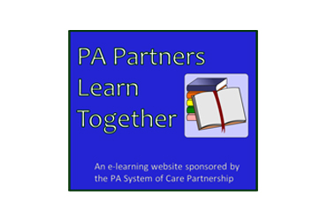
For More Information
To access the Family Member Roadmaps use the address or link below. Once on the PA System of Care Partnership website click the Pa Partners Learn Together icon .
http://www.pasocpartnership.org/
To view the modules outside of the Learning Management System visit http://www.pasocpartnership.org/family-partner/team-up-for-your-family-roadmap-training-tuff/

