Slide 1
Garrett Lee Smith Youth Suicide Prevention Grant in Schools & Colleges
This powerpoint was funded under award SM061750 by the Substance Abuse and Mental Health Services Administration (SAMHSA). The views expressed herein do not necessarily reflect the official policies of the Department of Health and Human Services, nor does mention of trade names, commercial practices, or organizations imply endorsement by the U.S. Government. Additionally, the Garrett Lee Smith grant team does not specifically endorse any one model or program related to suicide prevention.

Slide 2
Project Goals
Project Goals
Increase the number of
staff in schools, colleges, and universities trained to identify/refer youth at risk for suicide
youth screened and referred for treatment
clinical service providers trained to assess, manage, and treat youth at risk for suicide
Increase awareness about youth suicide prevention among youth, families, educators, and community members
Implement sections of the 2012 National Strategy for Suicide Prevention to reduce rates of suicidal ideation, attempts, and deaths
Promoting state-wide, systems-level change to advance suicide prevention efforts

Slide 3
How Schools Can Help Prevent Suicide
Protocols for helping students at risk of suicide
Protocols for responding to suicide death
Parent Education
Student Education
Screening
Staff education training
(SAMHSA, 2012)

Slide 4
Act 71
Beginning with the 2015-2016 school year, each school entity shall:
Adopt suicide prevention policies and procedures
Develop a professional development plan to provide 4 hours of suicide awareness and prevention training every 5 years
Any policy adopted by a school entity shall include
Protocols for administering youth suicide awareness and prevention education to staff and students

Slide 5
Suicide Prevention Training Topics
Cognitive-behavioral therapy for suicide prevention (CBT-SP)
Attachment-based family therapy (ABFT)
Gatekeeper
Specialized
Clinical
Suicide risk assessment
Safety Planning
Postvention
Family Engagement
Myths
Risk and protective factors
Warning Signs
How to respond to youth who may be suicidal

Slide 6
Question, Persuade, Refer (QPR)
Gatekeeper Training: Designed for anyone who is strategically positioned to recognize and refer someone at risk of suicide (e.g., parents, friends, neighbors, teachers, coaches, caseworkers, etc.)
Question The individual’s desire or intent regarding suicide
Persuade The individual to seek and accept help
Refer The individual to appropriate resources

Slide 7
Suicide Prevention Online Learning Center
Trainings based on role
Courses/classes
Pre-test/post-test
Certificates of completion
Print transcript for Act 48 credit

Slide 8
PDE’s Priority Teacher Training Topics
Suicide Prevention 101 and Debunking Myths
School-Related Epidemiology
Risk Factors vs Warning Signs
Risk and Protective Factors
Warning Signs
Review of School District Policies and Procedures
How Educators Can Respond to Youth about Whom They are Concerned
Safe Messaging
Postvention

Slide 9
Behavioral Health Screen
BH-WorksTM screens for risk behavior and psychiatric symptoms
Clinically validated scales (ages 12-24) that are predictive of risk behaviors (Diamond et al., 2010)
Standardizes screening questions across providers and patients
Covers areas recommended by the American Academy of Pediatrics as best practice guidelines for a well-visit interview
Web-based tool that takes 7 - 10 minutes
English, Spanish, Korean, or Mandarin
Adult, Adolescent, School, and Emergency Department versions available
Can track changes over time and can aggregate and export data

Slide 10
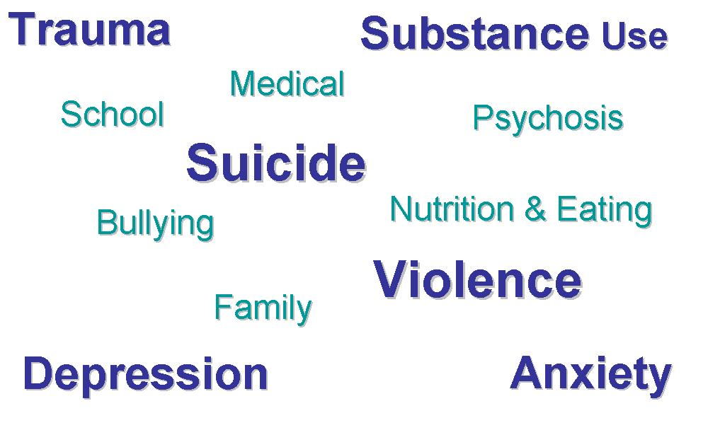
BHS – A Broad-based Tool
Web-based screening efficiently addresses identification and prevention by
Covering 13 Domains in approximately 7 minutes
Identifying Critical Issues:
Suicide, Violence, Gun Access
Automatically Scoring:
Depression, Suicide, Anxiety, Trauma, Substance Abuse, Eating Disorder
Identifying Risk Behaviors:
Substance Use, Safety, Bullying
Identifying Patient Strengths:
Grades, Exercise
Notes:
Go to: https://bhworks.mdlogix.com
* Login as Staff
* Username: demo@demo.com
* PW: demo123

Slide 11
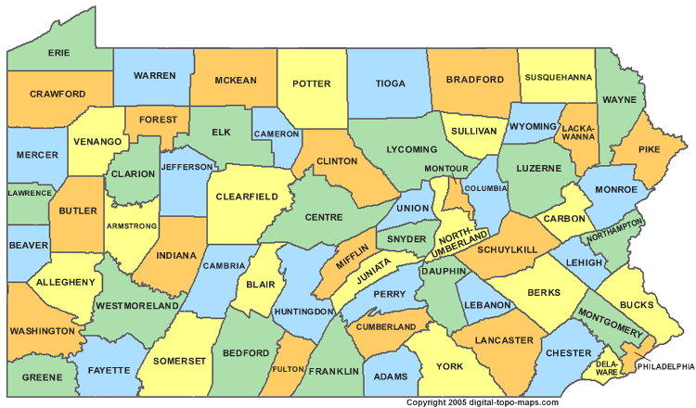
Implementation of Training and Screening
Implementation of Training and Screening
Training
Screening
Training and screening
Notes:
YEAR 1 → 26 Counties (training OR screening)
YEAR 2 → 33 Counties (training and/or screening)
YEAR 3 → 52 Counties (training and/or screening) ~78% of counties

Slide 12
Student Programming
Support with selecting appropriate student curricula/programming
Awareness activities
Annual public service announcement contest
Partnership with Aevidum and the Jana Marie Foundation
2018 PSA Contest Submission Guidelines

Slide 14
How to Get Involved
For additional information about the GLS grant or to discuss school district participation, please contact:
Perri Rosen, PhD, NCSP
Project Director, GLS Youth Suicide Prevention Grant
Department of Human Services
OMHSAS Bureau of Children’s Behavioral Health
(717) 772-7858 – phone
(717) 303-4611 – mobile
c-prosen@pa.gov

Slide 15
Additional Resources
Prevent Suicide PA: https://www.preventsuicidepa.org/
Substance Abuse and Mental Health Services Administration. (2012). Preventing suicide: A high school toolkit. Available at www.store.samhsa.gov
Suicide Prevention Resource Center (SPRC) – Best Practices Registry: http://www.sprc.org/bpr
National Youth Behavior Survey Results (current data on depression and suicide): http://www.cdc.gov/mmwr/pdf/ss/ss6304.pdf
National Center for the Prevention of Youth Suicide: http://www.suicidology.org/Portals/14/docs/Resources/FactSheets/Youth2012.pdf
SPRC Safe Messaging Guidelines: http://www.sprc.org/library/SafeMessagingfinal.pdf

