Slide 1
February 12, 2020
York, Pennsylvania
Notes:
This presentation needs to have:
an introduction section with info and stats from your state laying out the problem and why you need HWC
A section for Law Enforcement
A section for Trauma Sensitive Schools
A section for Therapy on site and resources for the children and families
At the end of the presentation talk about how the notice might work in your community.

Slide 2
Before we get started
Handlewithcarewv.org
Andrea Darr
(304) 766-5898
Andrea.L.Darr@wvsp.gov
WV Center for Children’s Justice

Slide 3
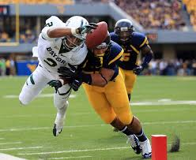
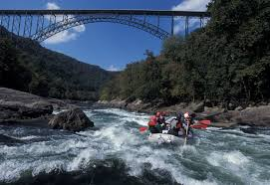
Wild Wonderful West Virginia
Notes:
Put in info from your state/county here.
We are a little smaller then South Carolina
We border Kentucky, Ohio, Pennsylvania, Maryland, Virginia,
We have a population of about 1,8 million
We have roughly 384,000 children
Department of Education is the largest employer in 29 or our 55 counties.
2015 Workforce WV - West Virginia’s top five largest private employers are Wal-Mart, West Virginia United Health System, Charleston Area Medical Center, Kroger, and Mylan Pharmaceuticals
2/3 of our base budget goes to Health and Human Services and Education

Slide 4
In West Virginia
Jobs – Coal is no longer King
24.6% of our kids live in poverty
Ground Zero for the Opioid Crisis
Highest Neonatal Abstinence Syndrome
Lead the nation in removing kids
2nd in Grandparents raising Grandkids
High rate of transient and displaced children
Notes:
Put in info from your state here.
RURAL - WV ranks among the most rural states in the country, with some 2/3 of its total population living in rural, usually nonfarm, areas ~June 21,2017 Britannica.com
JOBS - West Virginia is America's worst state for business in 2017 according to CNBC Top States for Business. A decline in coal production has hurt West Virginia's economy hard. Mining employment is down 40 percent in just the past five years, with some parts of the state losing as many as 70 percent of their coal mining jobs.
POVERTY – one in four kids live below the federal poverty line 2016
OD – More likely to die of an overdose in WV then any other state in the country. Last year we had 909. The national average is 19.8 per 100,000. We are 52 per 100,000. 5.7.18 We lead the nation in new cases of Hepatitis B, the national average was .9 and WV was 10. 2016 went up to 14.7. We are 2nd in the nation for Hepatitis C.
NAS – We lead the nation in Neonatal Abstinence Syndrome. The national average is 5 per 1,000. We are 50.6 cases per 1,000 live births (2017 dhhr.wv.gov/bph)
Transient kids
“Couch surfers”
Live with a number of family members, End up in Kinship care or foster care, May end up in juvenile detention facilities
Can end up be exploited and trafficked for survival
Common characteristics
Often exposed to abuse, violence, crime
Suffer physical an mental health conditions
Often lack a guardian who can provide consent
Pose tremendous challenges for the school and community
Child Welfare Crisis
Lead the nation in kids removed from their home
Kids are coming in younger with more complex physical & behavioral issues
CPS caseloads are double the national average
We do not have adequate CPS staff, foster homes and adoption options

Slide 5
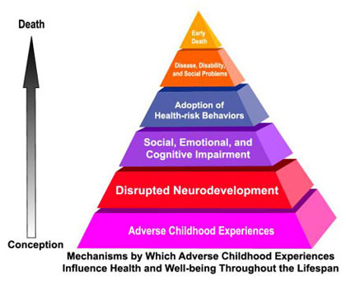
Prevalence of Trauma
The study demonstrated an association of adverse childhood experiences (ACEs) with health and social problems as an adult.
Among the approximately 17,000 adults surveyed, almost 2/3 of participants reported at least one ACE 1 out of 5 reported three or more
Notes:
Research shows that the prevalence of 10 specific ACEs—such as witnessing domestic violence or experiencing physical abuse—trigger a stress response that can harm a child’s developing brain. That stress and trauma weakens the immune system, increasing the risk of social, emotional, and health problems in later life, from suicide and substance abuse to diabetes, heart disease and cancer.
Back in the 1990s, Dr. Vincent Felitti, working with very obese adults, discovered that a shocking majority of his patients had suffered significant traumas during childhood. Eventually, his work led to a study involving 17,000 patients which showed the long-lasting effects of “adverse childhood experiences,” or ACEs, such as child neglect or abuse, or a parent with addiction or imprisoned. Those children often grow up to be adults who are more likely to be sick, to be violent, to miss work, and to marry often.
Almost two-thirds of the study participants reported at least one ACE, and more than one of five reported three or more ACE. The short- and long-term outcomes of these childhood exposures include a multitude of health and social problems.
~(http://www.cdc.gov/violenceprevention/acestudy/prevalence.html)
THE PROBLEM: PREVALENCE OF TRAUMA
1. Many students have had traumatic experiences.
Studies now show that nearly every school has children who have been exposed to overwhelming experiences, such as witnessing violence between their caretakers, being the direct targets of abuse, and other kinds of adversity. The Adverse Childhood Experiences (ACE) study found higher levels of traumatic experiences in the general population than previously imagined. Among the approximately 17,000 adults surveyed, just over 50% reported having experienced at least one form of childhood adversity. These included physical, emotional or sexual abuse; witnessing their mother treated violently; having a parent with substance abuse or mental health issues; or, living in a household with an adult who had spent time in prison.
If we add those who are chronically bullied, experience periods of homelessness, live in the proximity of pervasive community violence, flee war-torn countries, undergo multiple invasive medical procedures, or live with a parent traumatized by recent combat, the number of children affected by significant adversity grows even larger.
Experts explain that trauma is not an event itself, but rather a response to one or more overwhelmingly stressful events where one’s ability to cope is dramatically undermined. These experiences in childhood can lead to a cascade of social, emotional and academic difficulties. As students get older, exposure to traumatic experiences can also lead to the adoption of self-medicating behaviors such as substance abuse, smoking, and overeating. All of these responses to traumatic events can interfere with a child’s ability to learn at school.
~https://traumasensitiveschools.org/trauma-and-learning/the-problem-prevalence/

Slide 6
Not unusual for a newborn in WV to have 4 ACE’s
1. They live in a home with substance abuse.
2. Which increases their risk of maltreatment
3. Domestic violence and substance
abuse often go hand in hand
4. A parent incarcerated
Notes:
How prevalent ACEs are in WV

Slide 7
ACEs tend to get passed down from generation to generation.
Our Drug Endangered Children are having Drug Endangered Children
Notes:
Our Drug Endangered Children are having Drug Endangered Children
S They have no sense of feeling safe in their own skin or their environment
A They don’t know how to healthy attachments to others
R They don’t know how to self regulate
A They don’t know how to act

Slide 8
Ground Zero for the Opioid Crisis
Law Enforcement
EMS
Public Health
CPS
Schools
Notes:
What do you think of when you hear “Ground Zero for the Opioid Crisis” which for us is now the methamphetamine crisis
LE Drugs, criminal behavior to feed the drug addiction, arrests
EMS Overdoses and Narcan
PH Increase in Hepatitis B and C and HIV and Harm reduction Initiatives
CPS Removal of Children and no place to put them
No one is making the connection that this is blowing up the schools.
You might think it’s not your child but your child is sitting next to a traumatized struggling child and the teacher is spending all her time redirecting the behavior so no one is learning.

Slide 9
Trauma in Children
Turns off the learning switch!
Notes:
TRAUMA TURNS OFF THE LEARNING SWITCH
All of these responses to traumatic events can interfere with a child’s ability to learn at school.

Slide 10
Impact of Trauma on School Performance
Decreased reading ability
Lower GPA
More suspensions and expulsions
Increased drop-out
Higher rate of school absences
Which Can Lead to Serious social problems
Homelessness, Prostitution, Inability to sustain employment, Delinquency, violence, and criminal behavior, Re-victimizations, Intergenerational transmission of abuse, Long term use of health, behavioral health, correctional and social services,
Compromised ability to parent
Notes:
Taken from Ann Jennings, Ph.D. “The ACE Study & Unaddressed Childhood Trauma

Slide 11
It happens everyday . . .
Notes:
Describe a scene where police are called and children are present
Where is this child the next day?
Do they have their homework?
Are they bombing a test?
Are they asleep at their desk?
Are they hungry?
Are they staring off into space?
Are they having an outburtst?
And what is the teacher doing?
Getting in their face and asking what is wrong with them?
Why can’t you do what I ask you to do?
Why can’t you bring in your homework?

Slide 12
Handle With Care
A program aimed at ensuring that children who are exposed to crime, violence or abusereceive appropriate interventions so they can succeed in school to the best of their ability.
Research shows that trauma can undermine children’s ability to learn, form relationships and function appropriately in the classroom.
FOCUS BEHAVE APPROPRIATELY LEARN

Slide 13
The Problem
A recent national survey found that 60% of American children have been exposed to violence, crime, or abuse in their homes, schools or communities – and that 40% were direct victims of two or more violent acts.
Office of Juvenile Justice & Delinquency Prevention.2009. Children’s Exposure to Violence: A Comprehensive National Survey. http://www.ojp.usdoj.gov/ojjdp
Notes:
This was a wake up call to the country!

Slide 14
HWC Timeline
Office of Juvenile Justice Survey
Attorney General Eric Holder launched DCI
2011 WV Children’s Justice Task Force formed a
subcommittee to look at programming
Developed the HWC program
Piloted the HWC program
WV State Police launched HWC statewide
Stakeholder meeting in every WV county
2019 HWC is in 27 states around the country

Slide 15
Handle With Care *Kids being successful in school*
Kids at risk tend to:
Skip school
Use drugs
Become violent
Commit crimes
End up meeting Law Enforcement
HWC intervention:
LE identifies children at the scene
The school is notified before school starts the next day.
We all handle the child with care and respond in a trauma sensitive way.
Notes:
If Law Enforcement encounters kids at the scene, these are the kids most at risk.
In the past, the only kids that were identified and got services were the kids who Law Enforcement had to make a mandated report on. Most kids do not reach that threshold.
Handle with Care catches the children most at risk so they can be handled with care and have access to services and resources should the need arise.

Slide 16
Handle With Care
Police encounter kids at the scene and send “heads-up” HWC notice to the school.
Schools prep trauma-sensitive support for these kids.
Mental health providers partner for on-site therapy.
Notes:
TALKING POINT: Law enforcement identifies children at the scene and notifies the school before the start of the next day.
TALKING POINT: School staff are prepared to “handle the child with care” and respond in a trauma sensitive way.
TALKING POINT: Schools partner with mental health professionals to provide therapy at the school.

Slide 17
Charleston PD
HWC PILOT
Mary C. Snow Elementary
Notes:
We piloted the program with the Charleston Police Department and Mary C. Snow Elementary School.
We created the form so it could be self explanatory why we send the notice.
The trick is how to get the notice from the law enforcement officer, up through the chain of command and over to the school before the start of the next school day.
Every county does it differently based on what works in their county

Slide 18
Crime Mapping from the
West Side of Charleston
2010-2012
Burglaries
Child Abuse
Domestic Violence
Malicious Wounding
Robbery
Wanton Endangerment
Murders
Notes:
Why we chose this school to pilot HWC.
The following are crime mapping slides for crimes around our pilot school.

Slide 19
Burglary
Notes:
The little blue dot is the school. The red is reports of crime in the area to the Charelston Police Department.
This looks like a large area, it is two miles from each bridge crossing the river. This is a very small area.

Slide 20
Child Abuse Reports

Slide 21
Domestic Violence

Slide 22
Malicious Wounding

Slide 23
Robbery

Slide 24
Wanton Endangerment

Slide 25
Murders

Slide 26
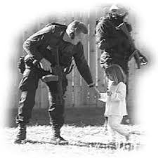
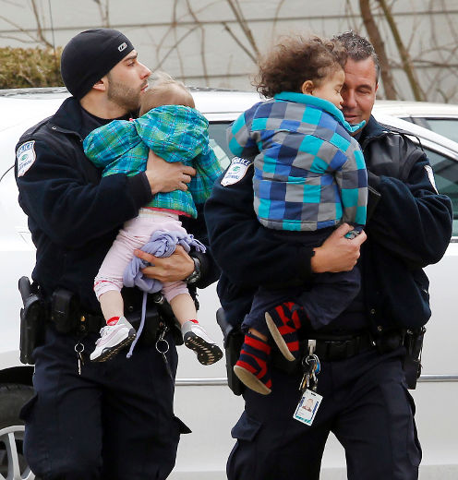
Who gets a HWC notice?
A child exposed to crime, violence or abuse.
If you have to ask “Should I send a HWC notice?” then you need to send one.
Send one on every child, it’s not our place to judge what is traumatizing

Slide 27
Examples of HWC notifications
Arrest of household member
Search warrant served in residence
Drug/alcohol overdose of family member
Death/Suicide of family member
Incident of domestic violence
Physical/sexual abuse
Community violence
Forced displacement from residence
House fires

Slide 28
Law Enforcement sending the HWC Notice to the School
It needs to be at the school
at the start of the school day!
Notes:
Talking points: Every county is different and you need to decide what works best with the resources you have. Here are some suggestions.

Slide 29
Handle With Care August 2013 – February 2016
Total Incidents: 580 HWC Notices
Kids Involved: 1056 Kids
Notes:
We couldn’t believe the numbers that came back.

Slide 30
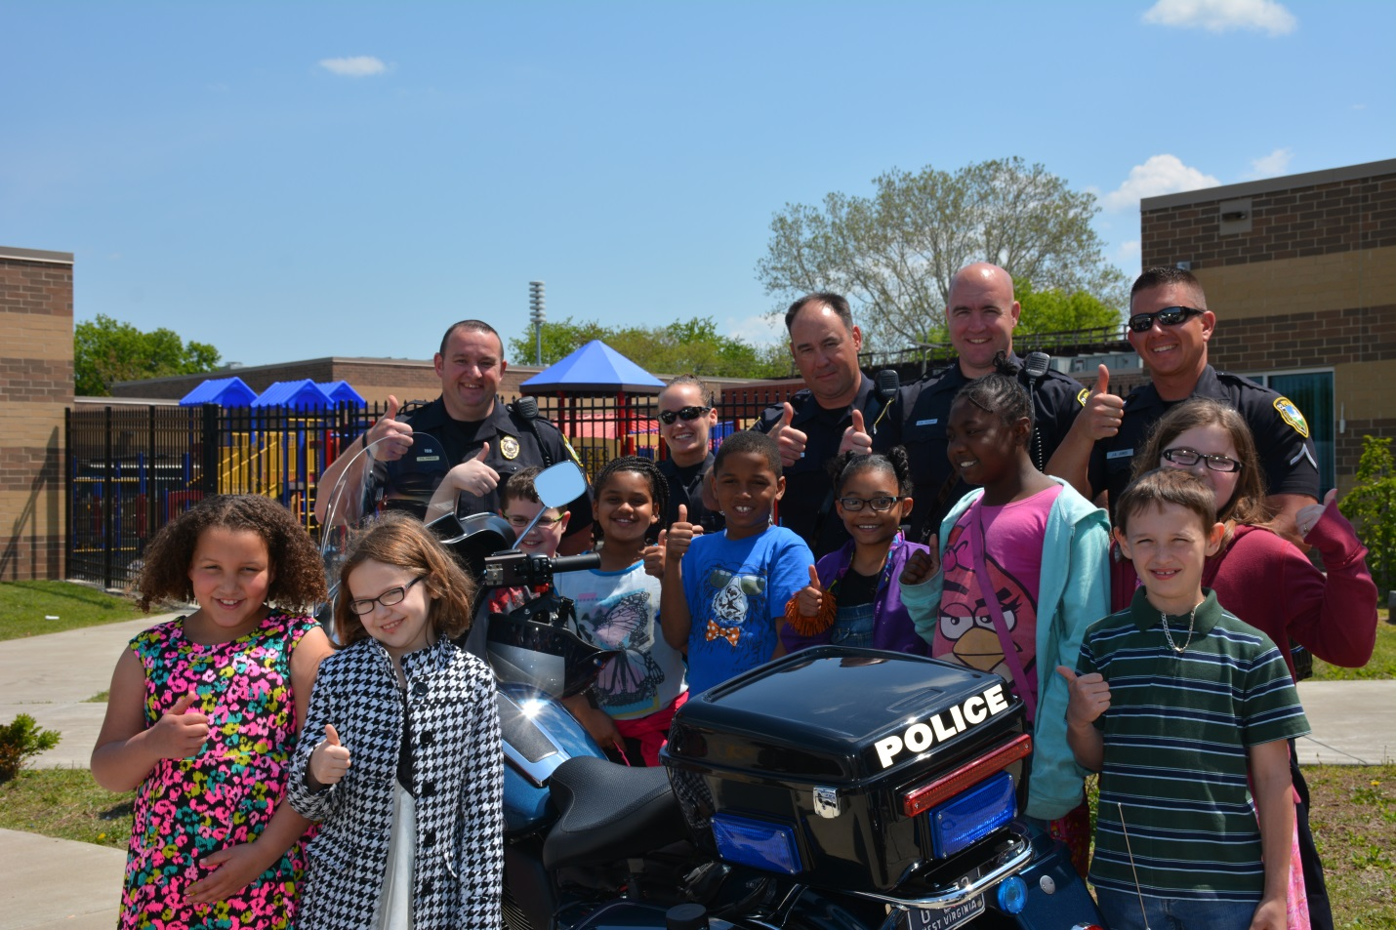
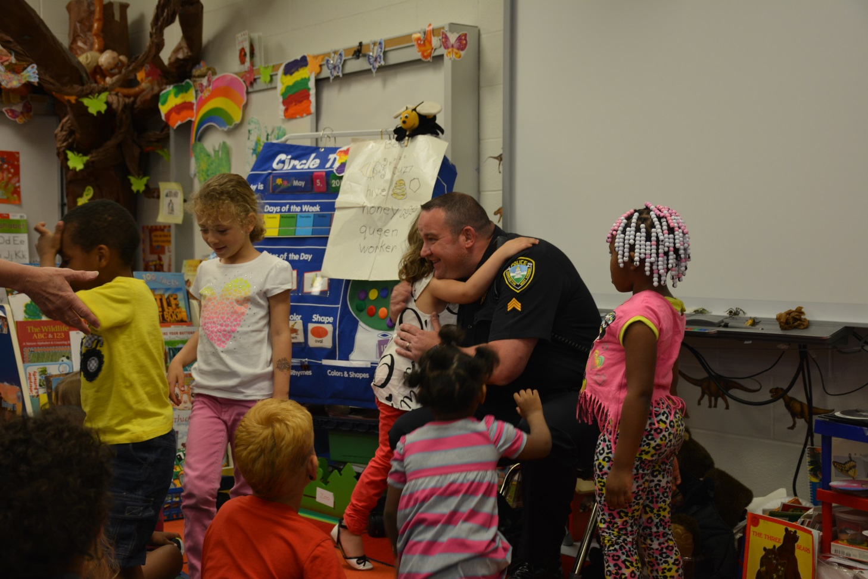
Building Relationships
Notes:
Another part of HWC . . .
When do kids see Law Enforcement? When bad things are happening. Let’s change that. Let kids see LE when nothing bad is happening!
Pick one day a week and have a school lunch. Take your cars, bikes, motorcycles for them to see. Go into classrooms and talk about leadership.

Slide 31
This Simple HWC Notice
Provides Law Enforcement with the ability to alert the school that this child was involved in a police incident last night and may have academic or behavioral problems today
No details are given
Just 3 simple words
Handle with Care
Notes:
You have to put someone in charge of the program who cares.
If the notice interrupts their lunch and that is an issue, odds are they should not be in charge
You can’t teach passion.
Roll call

Slide 32
HWC Notice
It arrives at the school before the start of the next school day.
Need to know basis only
Does not stay in child’s permanent record
Include child care serving agencies
School Internal HWC’s are very beneficial
It does not mean you approach the child

Slide 33
What is Trauma
Trauma describes a lasting response to experiences or circumstances that exceed and individual’s ability to cope and produce lasting adverse effects
(SAMSHA, 2014).

Slide 34
Trauma
It affects all people differently
Threat to life and well being
It can be acute or chronic
Safety has to be established to work through it
Creates triggers
Produces lasting adverse effects
Notes:
Unique individual experience of an event or an enduring condition. It affects all people differently. What traumatizes you might not traumatize me. Give example
Threat to life and well being. An overwhelming stress that exceeds ones ability to cope or to integrate emotions involved in the experience
It can be a one time event or a chronic situation
Safety has to be established again before you can make progress in working through the trauma.
Creates Triggers
Trauma and social well being are married

Slide 35
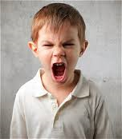
Trauma is . . . Under-Reported and Under Diagnosed
Often misinterpreted & assigned as symptoms of disorders (depression, Bipolar Disorder, ADHD, Oppositional Defiant Disorder, Conduct Disorder, Attachment Disorder, etc.)*
These diagnoses generally do not
capture full extent of developmental
impact of trauma.
*39% kids at pilot school have these diagnoses.
Notes:
We are under diagnosing trauma and over diagnosing disorders
It’s not the child cannot pay attention to anything, it’s that the child has to pay attention to everything in order to survive.
Every DSM-5 childhood diagnosis can be related to trauma or toxic stress: ADHD, ODD, psychosis, suicide attempts, aggressive behaviors

Slide 36
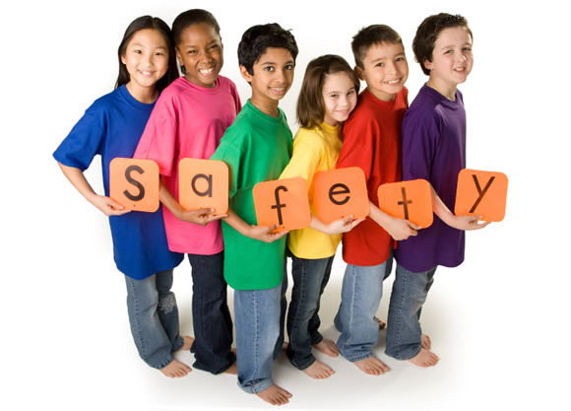
The Solution A Trauma Sensitive School
A respectful and safe environment where children can build positive relationships with adults and peers, learn to manage their emotions and behavioral responses, and find academic success.
Notes:
See Helping Traumatized Children learn

Slide 37
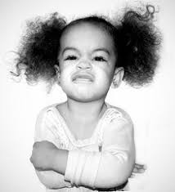
Childhood Trauma and Classroom Behavior
A traumatized child sees the world as a dangerous place, including the school. Unfortunately, many adopt behavioral coping mechanisms that can frustrate educators and evoke exasperated reprisal.
Reactivity and Impulsivity
Aggression
Defiance
Withdrawal
Perfectionism
Notes:
Children who suffer trauma are more likely to interpret people’s expressions as anger.
These reactions by the educator both strengthen expectations of confrontations and danger and reinforce a negative self-imagine.
To avoid reminders of the trauma, traumatized children adopt strategies (consciously or unconsciously) such as social withdrawal, aggressiveness, or substance abuse.
Encountering perceived threat leads to hyperarousal
Hyperarousal: physiological/emotional response to danger that prepares the flight, fight, or freeze response
Hypervigilance to danger interferes with regulation of emotion and accurate appraisal of a situation
Non threating stimuli can appear threatening
Triggers may appear positive to others.
Like a needle on a record player, complex trauma wears a groove in the brain. So when something non-threatening happens that reminds us of a traumatic incident, our bodies replay the traumatic reaction—mobilizing us to either run from or fight the threat, while shutting down other systems that help us think and reason. If this happens over and over, we become more easily triggered into that fear response mode, never giving our bodies time to recover. After awhile, as we adapt to this chronic triggering, our behavior can seem crazy or rude when taken out of the context of trauma.
~I forgot where I found this.

Slide 38
Why create a trauma sensitive school system?
Schools provide possibilities for traumatized children to forge relationships with caring adults and learn in a supportive, predictable, and safe environment.
Notes:
Supportive, Predictable, and Safe!

Slide 39
TRAUMA SENSITIVE SCHOOLS
Trauma sensitive requires acknowledging that, given those effects, traditional approaches (conflict resolution, behavior issues, mental health service delivery, etc.) can re-traumatize children and families.
Traditional teaching and discipline can trigger traumatic responses
What can we do to make you feel safe and comfortable so you can learn
Notes:
There are teachers going to school to learn how to teach children that do not exists.

Slide 40
*No one-size fits all approach
A School wide Approach to
Trauma-Sensitive Supports
Benefits all children whether or not we know they are traumatized
Involves the whole school staff
Provides teachers with the supports they need to address trauma’s impact on learning
Looks at child’s behavior from a different perspective
Notes:
Trauma-Sensitive Schools Environments Benefit all Children: Those whose trauma history is known, those whose trauma will never be clearly identified, those who may be impacted by their traumatized classmates.
Includes all staff from Principles, counselors, teachers, aids, cooks, custodians, bus drivers.
Educators sometimes see a misbehaving child as a bad kid or a mean or oppositional kid, when they might just be a scared kid. The child’s behavior is the result of chronic exposure to traumatic events beyond this or her control.
Apart from employing a mindfulness curricula, or classroom yoga practices, which also are gaining popularity, simply greeting students at the start of the day and “acknowledging their humanity” before diving into tasks will help, Moreno says. With all the demands placed on teachers, it can be difficult, even “radical,” for teachers to slow down the pace of their classes and to take time with every student, but it will pay dividends, she says.

Slide 41
Become a Trauma-Sensitive School
Blueprint for educators and communities to ensure that children traumatized by exposure to violence succeed in school
Understand the impact of trauma on learning & educate staff
Develop a plan to integrate trauma-sensitive routines & individual student supports
http://www.massadvocates.org/download-book.php
Notes:
This is our go to create trauma sensitive schools. The authors love our program and are our go to experts when we need help. Our work is based on their work.
It helps staff learn to recognize when kids go into survival mode and how to create calm predictable environments.
There is a book study of these books on our website that schools can use.

Slide 42
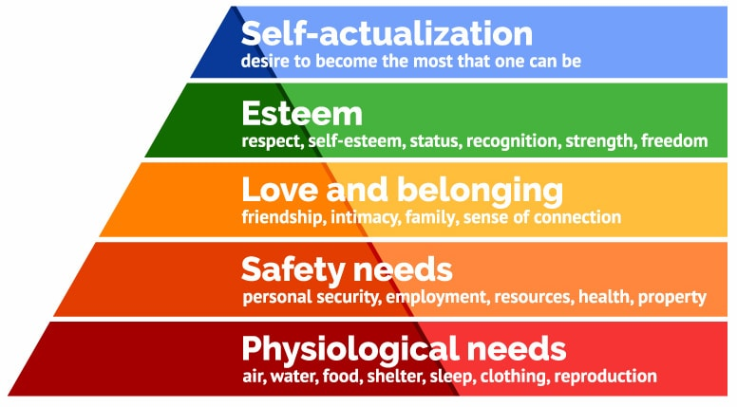
Ways to Handle Children with Care
Food, sleep, and clean clothes
Safe, predictable and supportive environments
Connection to a caring adult; clear expectations and boundaries
Empowerment for self-confidence
Choice to develop decision making skills
Notes:
TALKING POINTS: According to Maslows hierarchy of needs, needs lower down in the hierarchy must be satisfied before individuals can attend to needs higher up.
TALKING POINT: To learn, children’s basic and psychological needs must be met. They can’t be hungry or tired. They need to feel safe. They need feel loved and cared for. They need to know that you want them to succeed.
TALKING POINT: If a child with a HWC notice acts ups, teachers should send them to the nurse or counselor before the principal.

Slide 43
Notes:
Has losing your temper or shouting at a child resulted in a positive outcome?
Did it alleviate the stress of the situation?
Did you or the child walk away feeling good about the interaction?
Probably not.
Now consider the impact on a child with an attachment disorder, a child who has never received adequate emotional regulation from caregivers.
When you lose your cool
There are several unhealthy payoffs for a child when you become angry or upset:
You hand over control of the situation by reacting to the child. This erodes the child’s confidence in you as a reliable caregiver and safe authority figure: “How can I trust you when I have the power to make you so emotionally upset?”
You are allowing your child to replicate the stressful and dysfunctional patterns that he or she experienced in a prior home or institution: “I’m used to turmoil and conflict; I can do this well, and never have to change.”
You are reinforcing the child’s negative core beliefs: “Your anger and disapproval mean that I am bad and undeserving of love.”
Your child will take note of any tendency on you part to lower expectations in order to avoid conflict: “I can wear you down, you’ll leave me alone, and I’m off the hook.”
You are feeding into your child’s desire to avoid emotional closeness: “As long as we are mad at each other, I don’t have to be close.”
Over time, securely attached children internalize parental care and learn self-regulation. Children with an attachment disorder, however, did not develop the ability to regulate their emotions and impulses. They became behaviorally and biochemically disorganized, resulting in hyperarousal, aggression, impulsivity and distractibility. They overreact to stimulation, stress and anxiety. You can teach your child to be calm by role-modeling calmness. Calmness reduces the child’s ”alarm reaction” (fight-flight-freeze) and allows her to feel safe and secure enough to think rationally, learn a better way of behaving and coping while building trust with you.
~The power of calm by Terry Levy, October 8, 2018, Attachment, Corrective Attachment Therapy, Evergreen Psychotherapy Center.

Slide 44
Interventions
Food, sleep, and clean clothes
Safe, predictable and supportive environments
Connection to a caring adult
Clear expectations and boundaries
Choice to develop decision making skills
Empowerment for self confidence
Notes:
We can’t learn if we are hungry and tired
Safety
We cannot meet expectations of which we are unaware- Be clear about tasks/be clear about goals
Choice develops decision making skills, personal responsibility and elicits cooperation Example: Math or Science- What do you want to work on first?
Empowerment=involvement- competence. It is disempowering to make every decision for someone else, including children
They need to feel loved
They need to feel safe
Their basic needs will be meet
They need to feel cared for
And they know you we want them to succeed

Slide 45
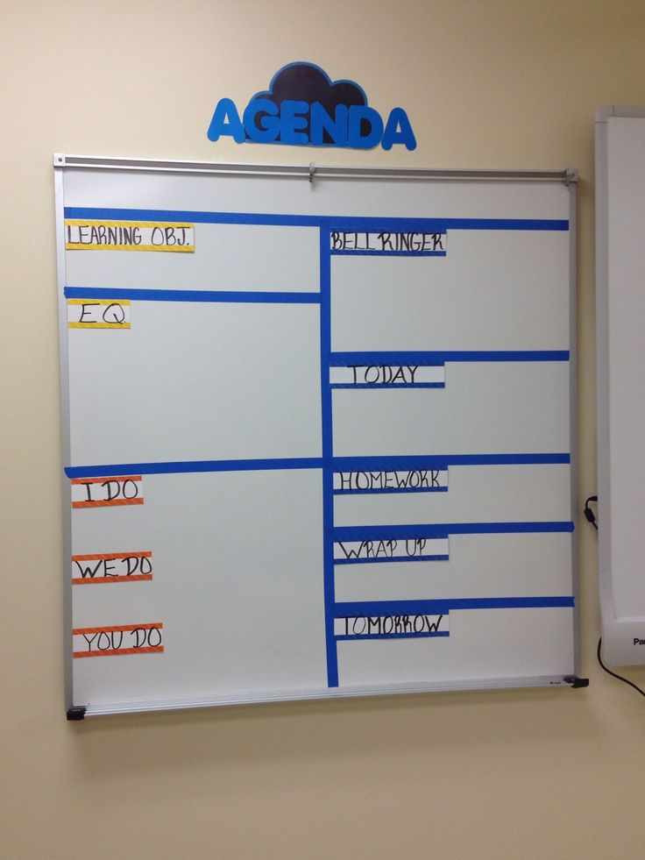
Individual Interventions

Slide 46
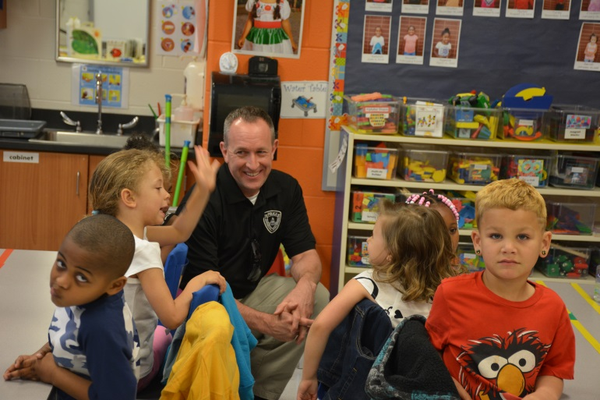
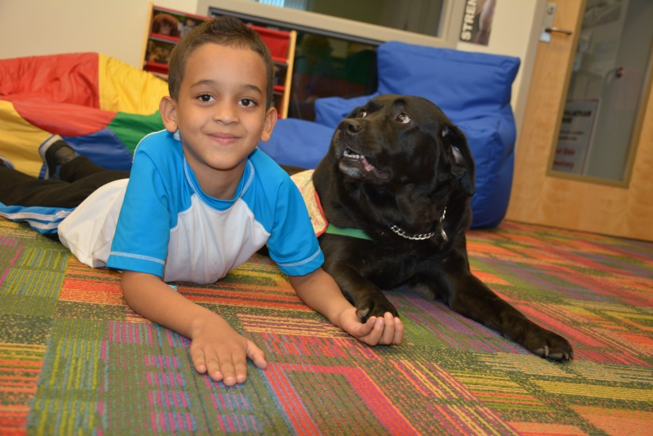
School Interventions
Thumbs Up
LE visiting classroom
Therapy Dogs
Notes:
Thumbs up
Mentors
Therapy Dogs
LE Officers visiting school
Fostering closer relationships
Classroom interventions

Slide 47
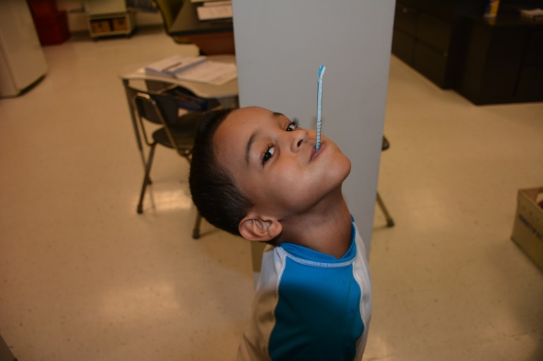
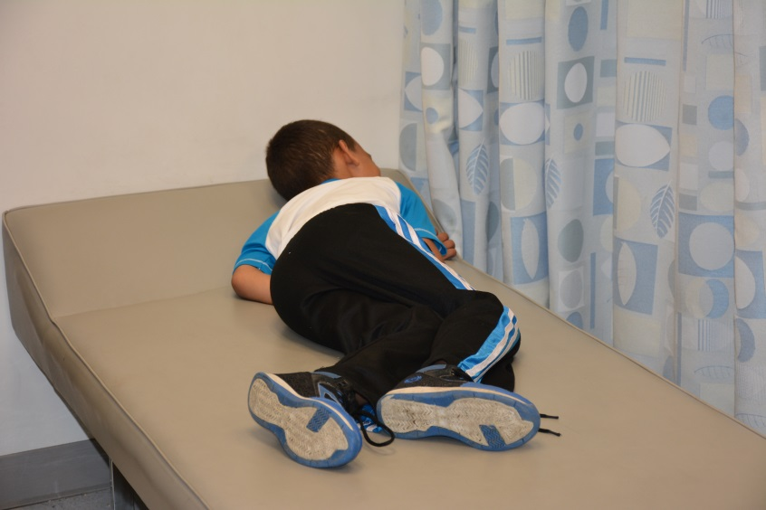
Individual Academic Interventions
Postpone
testing
Rest
Retesting
IEP
Notes:
Rest
Retest
Postpone testing
IEP

Slide 48
Individual Behavioral Interventions

Slide 49
School Response without HWC Intervention
Comes to school without homework
Naturally he got a zero
Fell asleep in class
Lost his recess
Got into a scuffle at lunch
Received detention
Didn’t bring permission flip for field trip
Had to stay back and read in the library
Notes:
Johnny is in the 5th grade and typically comes to school a little disheveled and has trouble paying attention in class. With little redirection he gets by.
Johnny had a bad day that will likely continue to snowball due to a drop in grades, teacher perception and Johnny’s experience with school.

Slide 50
School Response with HWC Intervention
Comes to school without homework
Math teacher gave extra time to do homework and offered 1:1 help if he needed it
Fell asleep in class
Sent to the school nurse to get some rest
Got into a scuffle at lunch
There was no scuffle because he was rested and supported throughout the morning. He had a good lunch with no issues
Didn’t bring permission slip for field trip
Homeroom teacher made a phone call to his family and got verbal permission over the phone
Notes:
Johnny is in the 5th grade and typically comes to school a little disheveled and has trouble paying attention in class. With little redirection he gets by.
First thing in the morning, the school received an email from the local police department that simply stated “Handle Johnny with Care”
His teachers were made award that something happened in Johnny’s home last night that involved Law Enforcement. They knew he might not be himself that today.
The guidance counselor made it a point to say hello and welcome him to school and reminded him that she is always there if he needs anything
Johnny’s day was pretty good.

Slide 51
Handle with Care
Does not excuse bad behavior
Children are still accountable for their actions
HWC seeks to provide students with tools and skills to appropriately respond in an acceptable manner
Notes:
Handle with Care is never a pass for bad behavior.
A trauma-informed model builds positive caring adult relationships through holding kids. . ACCOUNTABILITY. . . Example (In school suspension vs. out of school suspension)

Slide 52
What if school interventions are not enough?
Notes:
Some kids will need to talk to a therapist. And if the therapist is on site at the school we do not have to worry about the parents getting the kids to their appointments.
Parents have to give permission for the services.

Slide 53
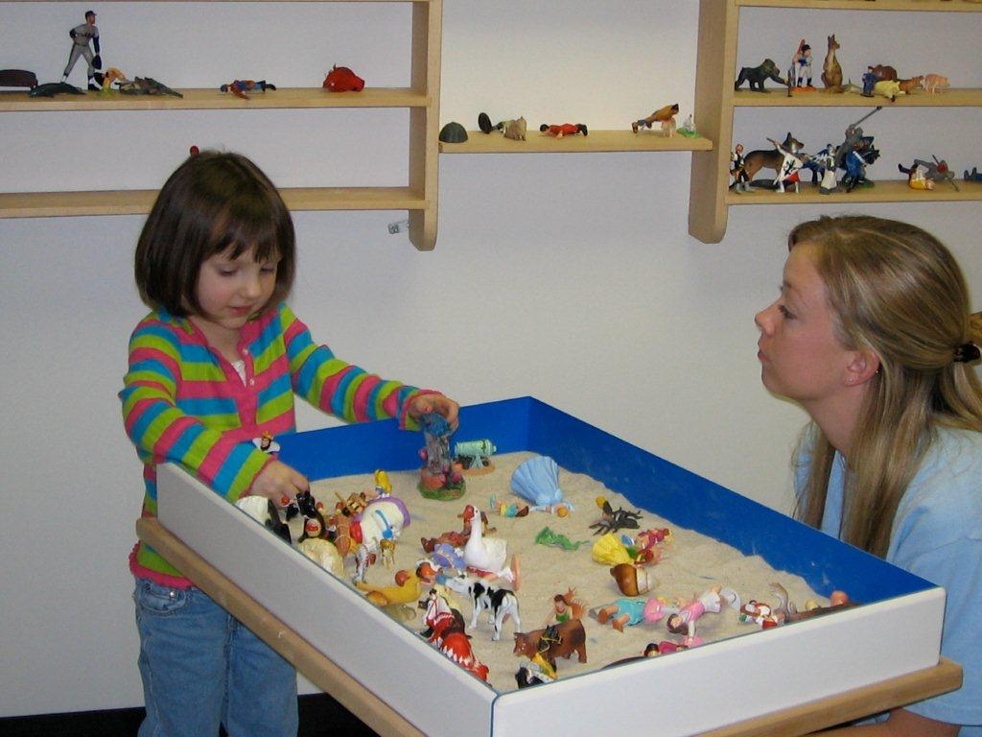
MH Providers, teachers and school personnel
work as a team to best serve the child

Slide 54
HWC In Summary
Identifies the kids most at risk
Provides teachers with a heads up
Connects children with accessible mental health services if needed
Strengthens and improves relationships in the community.
Thus improving academic, social-emotional and behavior outcomes

Slide 55
Handle with Care
January 2020
Washington
Montana
Maine
North Dakota
Minnesota
Vermont
Oregon
New Hampshire
Idaho
South Dakota
Wisconsin
New
York
Massachusetts
Wyoming
Michigan
Rhode Island
Connecticut
Iowa
Pennsylvania
New Jersey
Nevada
Nebraska
Indiana
Ohio
DC
Delaware
Utah
Illinois
West
Virginia
Maryland
California
Colorado
Virginia
Kansas
Missouri
Kentucky
North
Carolina
Oklahoma
Tennessee
Arizona
New Mexico
Arkansas
South
Carolina
Alabama
Georgia
Mississippi
Texas
Louisiana
Alaska
Florida
Hawaii
Interest
Development Phase
Active

Slide 56
Save the Date!
WV Center for Children’s Justice
Handle with Care Conference
October 14-16, 2020
Civic Center
Charleston, WV
www.handlewithcarewv.org

Slide 57
In closing
Success in school is success in life.
Let’s help children succeed in school everyday to the best of their ability!
Notes:
This is why we do Handle with Care!

Slide 58
Let’s Make Handle With Care Successful in Your Community!
QUESTIONS?
Andrea Darr
(304) 766-5898
Andrea.L.Darr@wvsp.gov
WV Center for Children’s Justice

