Slide 1
Light The Way For Mental Health
Light Up Green Tool Kit

Slide 2
BRANDING

Slide 3
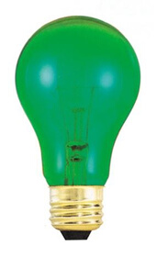
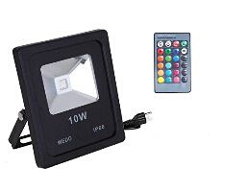
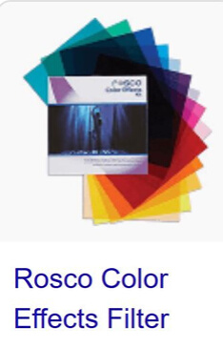
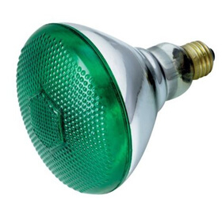
LIGHTS
#90 Dark Yellow Green
#389 Chroma Green

Slide 4
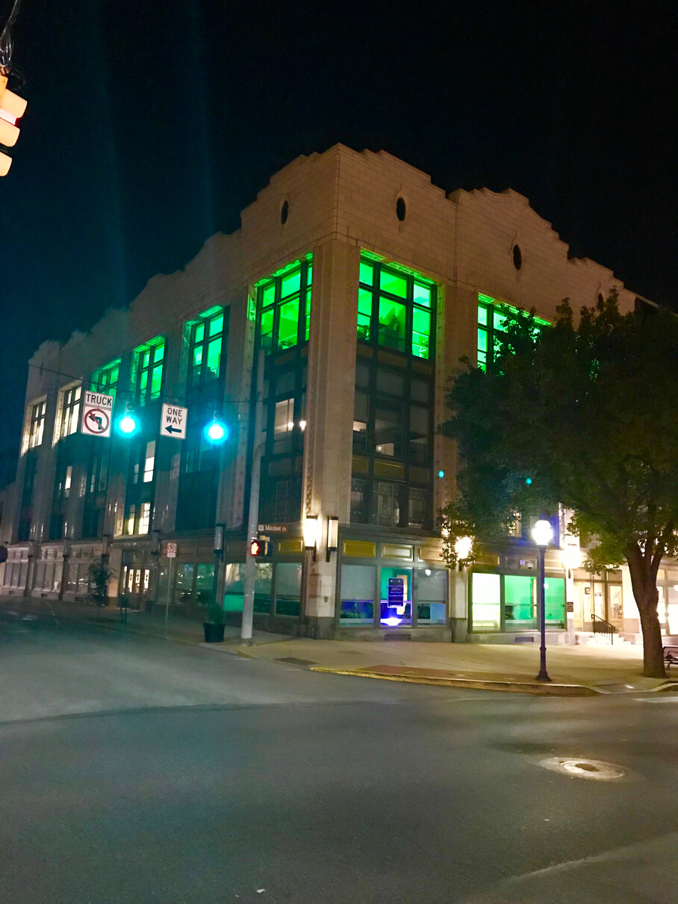
SHINE. SHARE. SHOW.
Shine Green
Share Message
Show Community

Slide 5
Light It Up Green!
Kick-Off Walk

Slide 6
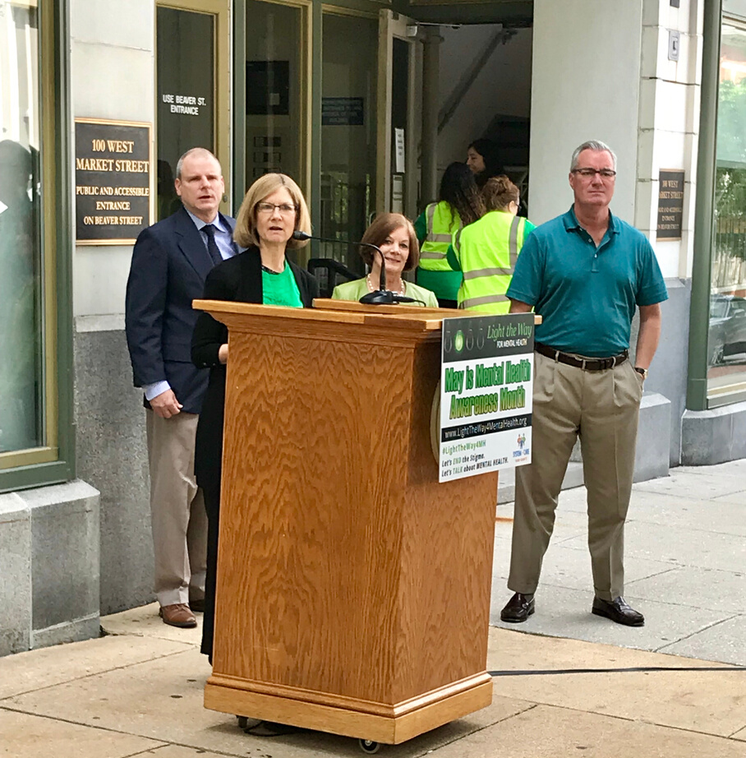
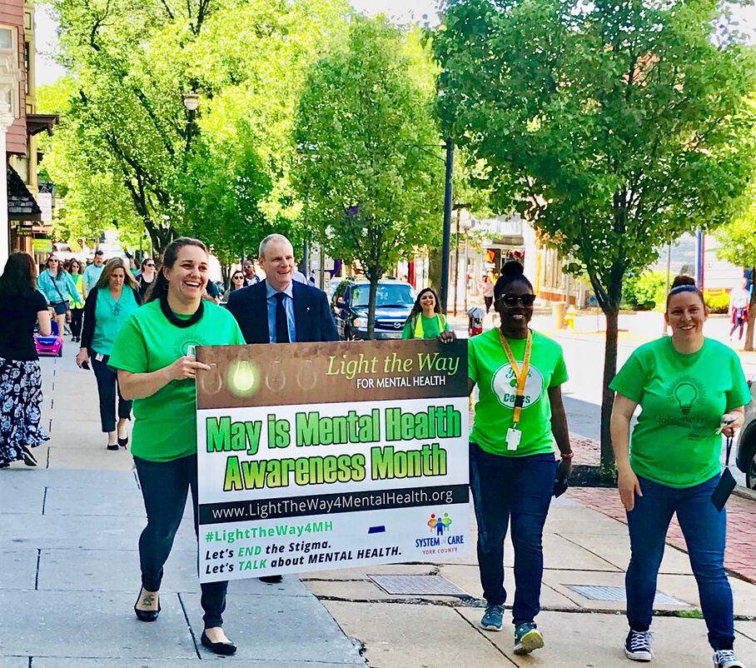
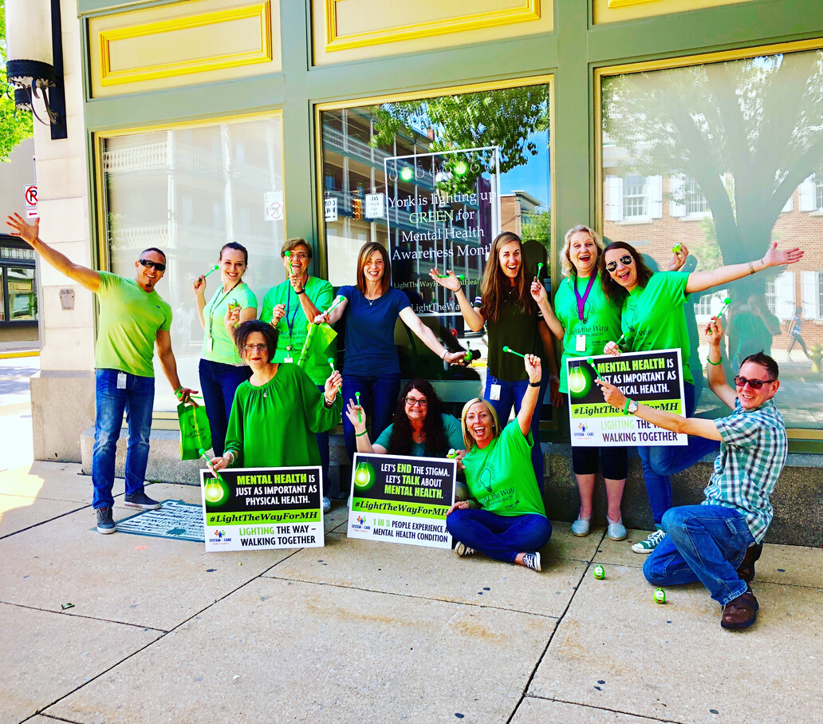
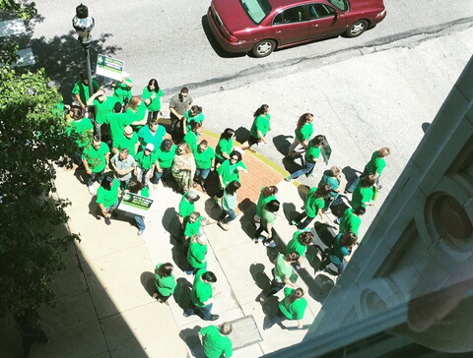
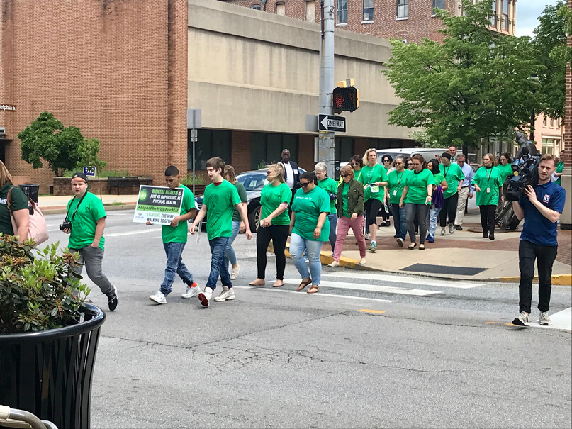

Slide 7
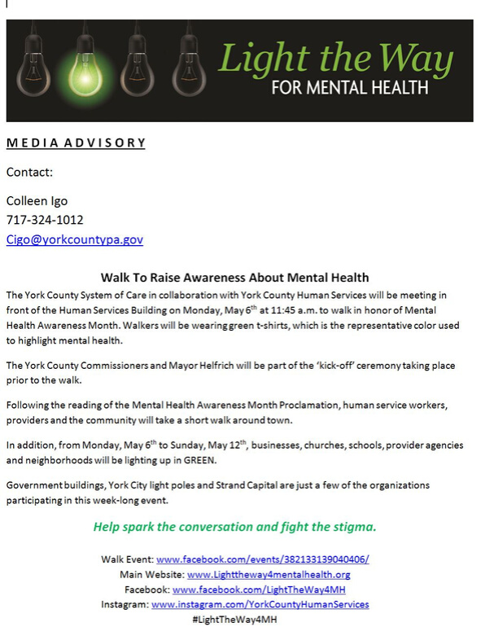
Participants:
Administrators
County & City Employees
Providers
Clients
Students

Slide 8
Light It Up Green!
Landmarks - Businesses - Neighborhoods

Slide 9
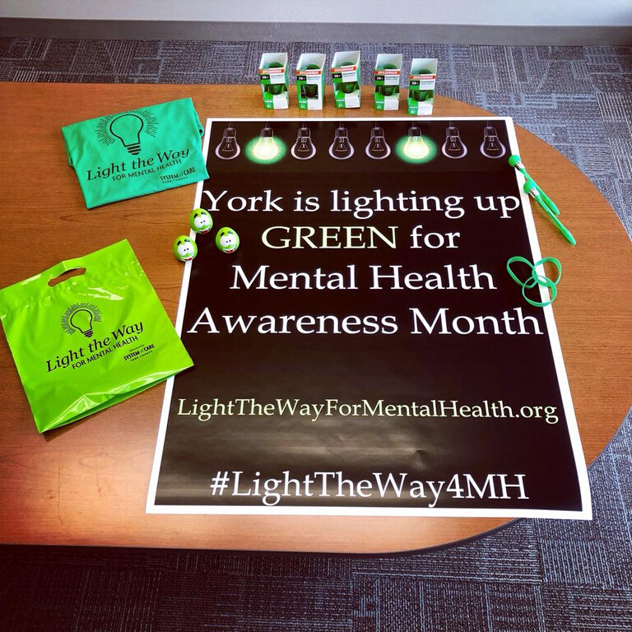
Give Aways
Stress ball
Pens
Bracelets
Ribbons
Glow necklaces

Slide 10
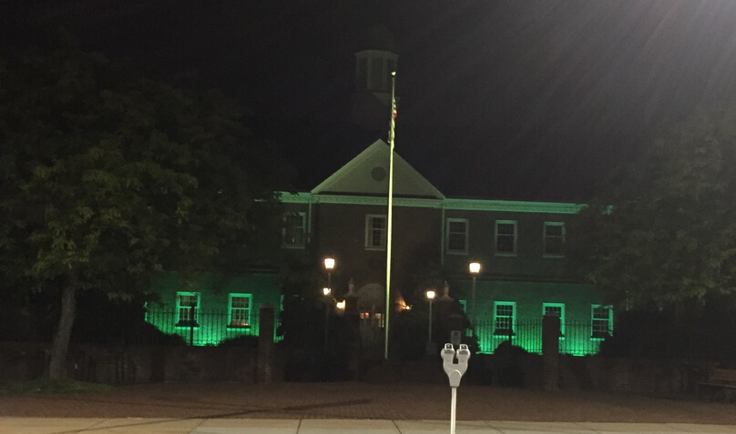
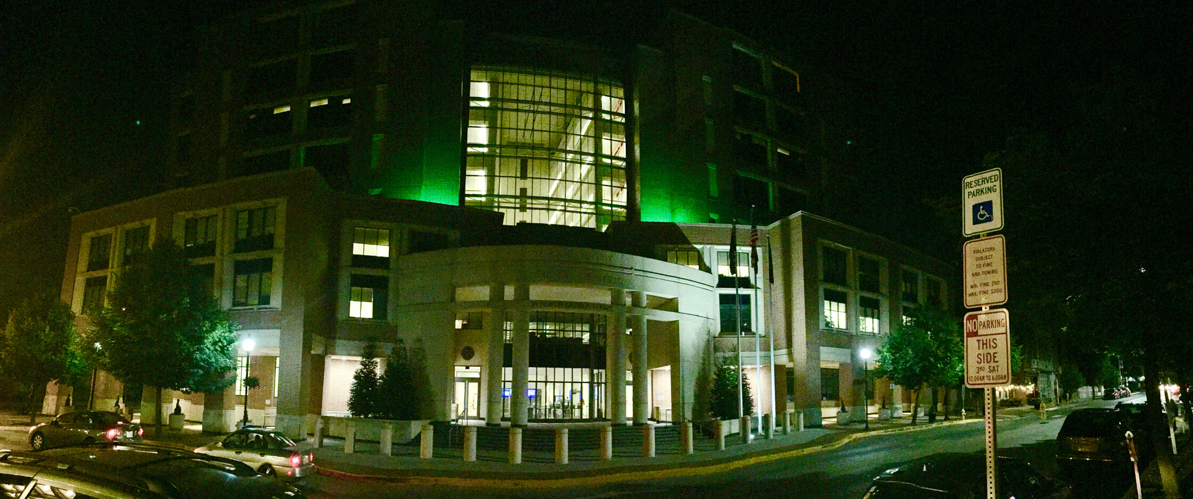
COUNTY LANDMARKS

Slide 11
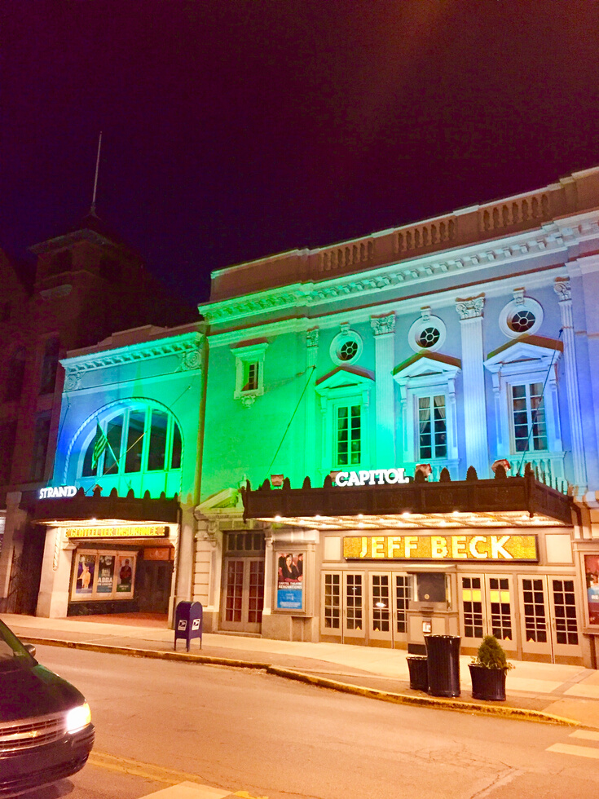
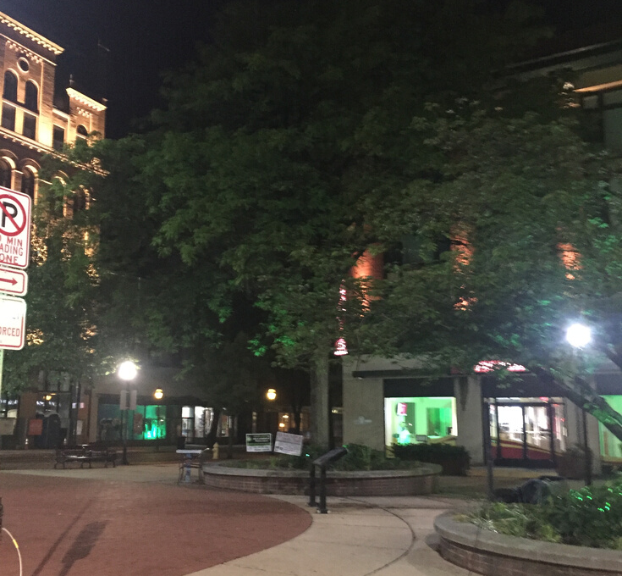
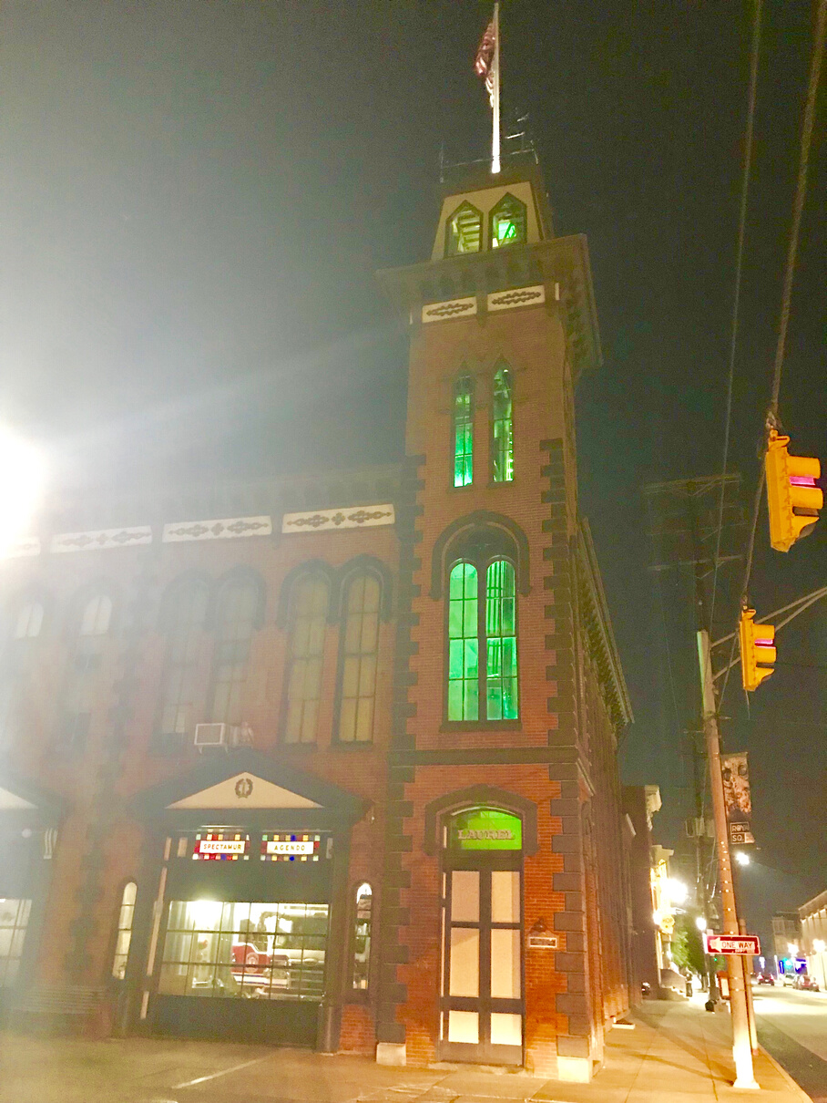
COMMUNITY LANDMARKS

Slide 12
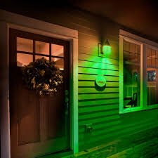
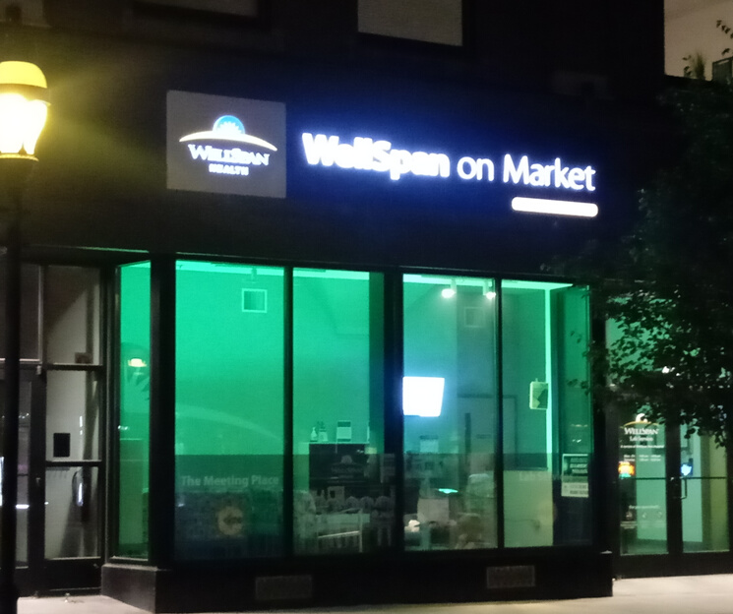
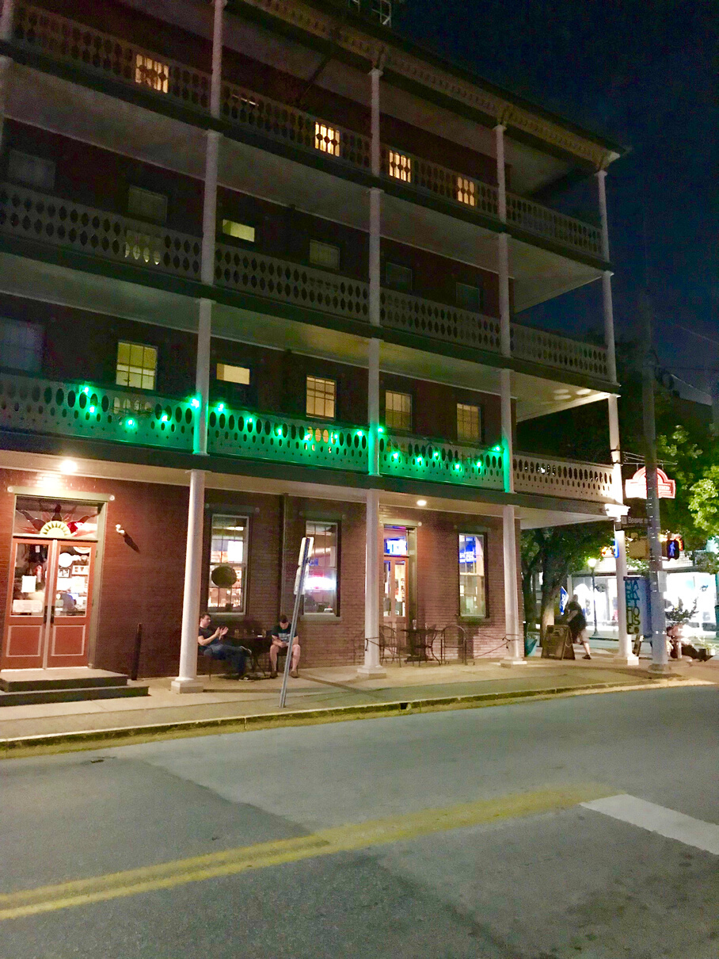
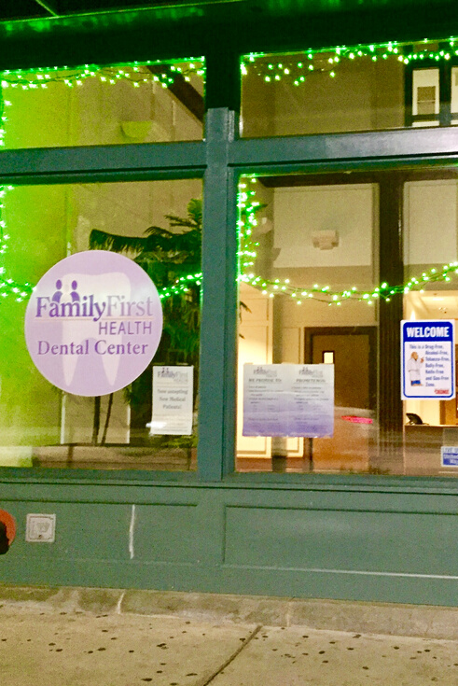
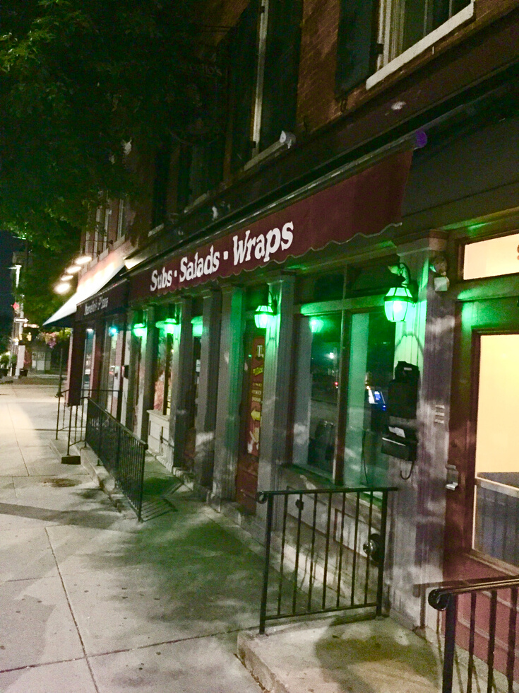
BUSINESSES & NEIGHBORHOODS

Slide 13
Light Up Your School Green Contest
Mental Health Awareness & Public Service Announcement

Slide 14
https://yorkcountyhumanservices.org/school-contest-2019

Slide 15
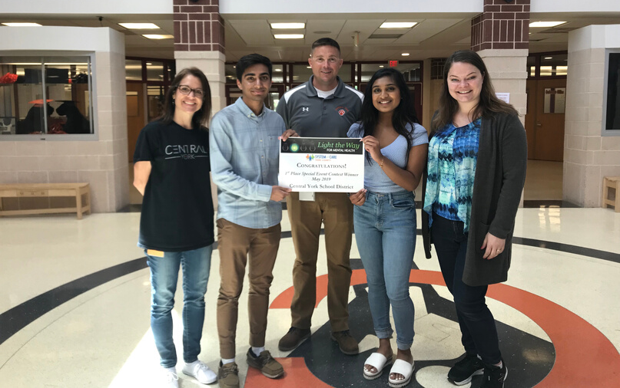
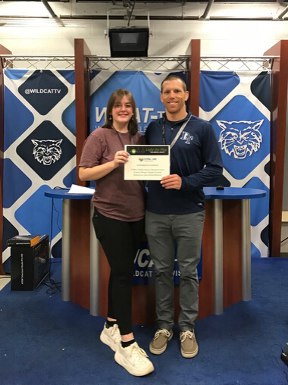
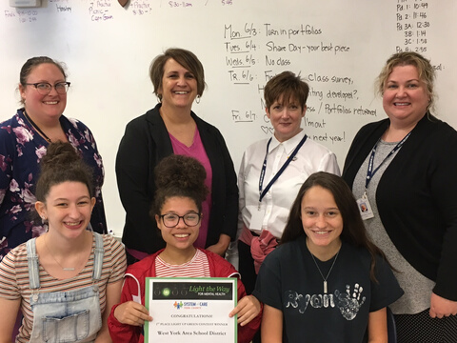
The 1st Place Winner of each Category received funds to advance mental health wellness & education within their respective district.

Slide 16
Teamed Up With Revs & Lamar Advertising
MH Fair - PSA - Singing Contest - First Pitch - Memorial - Fireworks

Slide 18
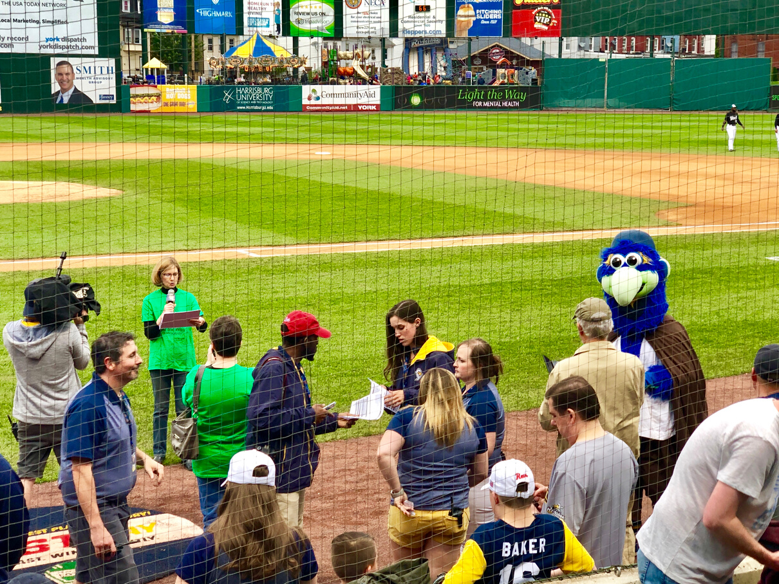
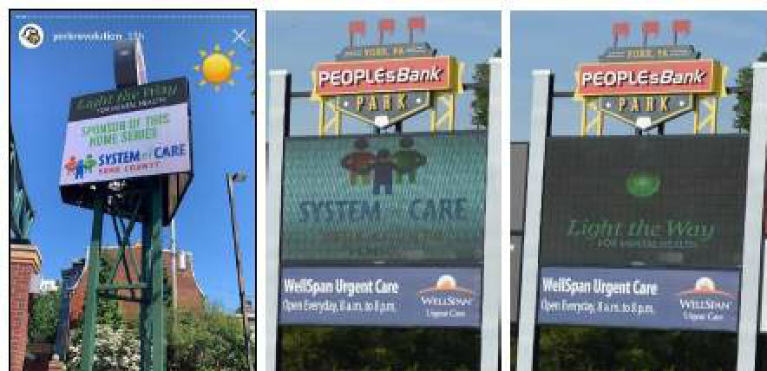
Opening Remarks
Public Service Announcement Winners

Slide 19
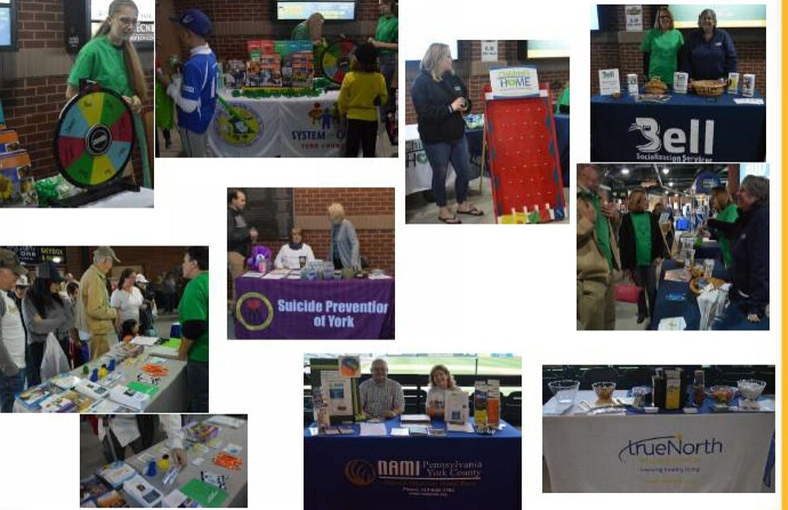
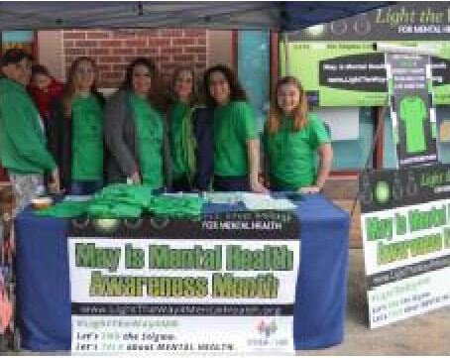
Mental Health Fair

Slide 20
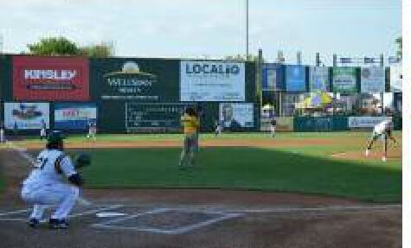
Singing Contest
First Pitch

Slide 21
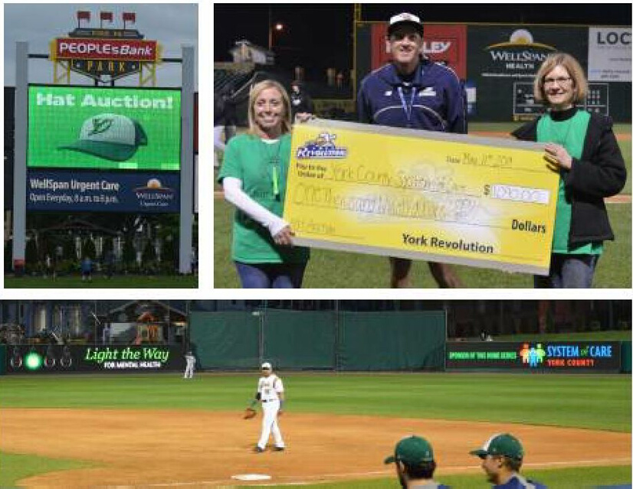
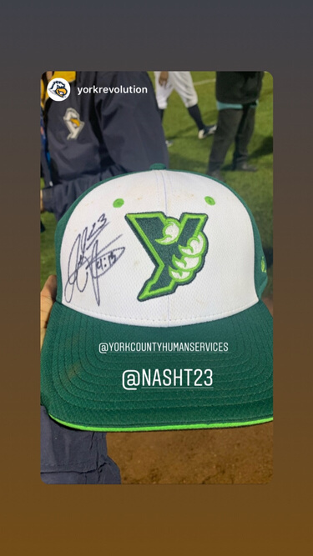
Hat Auction

Slide 22
Teamed Up With Suicide Prevention & Coroner's Office
Lighting Ceremony with Video

Slide 23
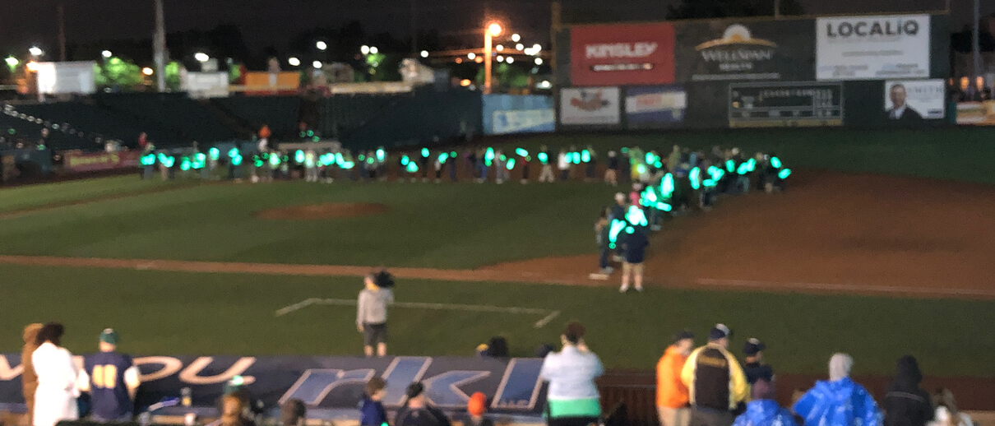

Slide 24
Communication

Slide 25
Billboards

Slide 26
Yard Signs

Slide 27
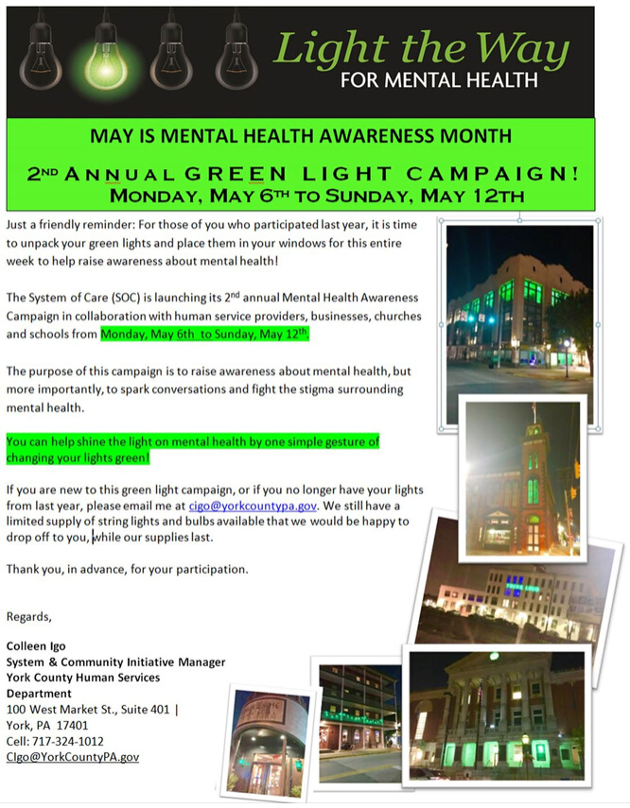
Eblasts

Slide 28
Social Media
www.facebook.com/groups/LightTheWay4MH/
Instagram: lighttheway4mh
LightTheWay4MentalHealth.org
#LightTheWayForMH

Slide 29
Help spark the conversation &
fight the stigma.
Shed the Light on Mental Health!
Colleen Igo
System & Community Initiatives Manager
717-324-1012
cigo@yorkcountypa.gov

